Slide 1

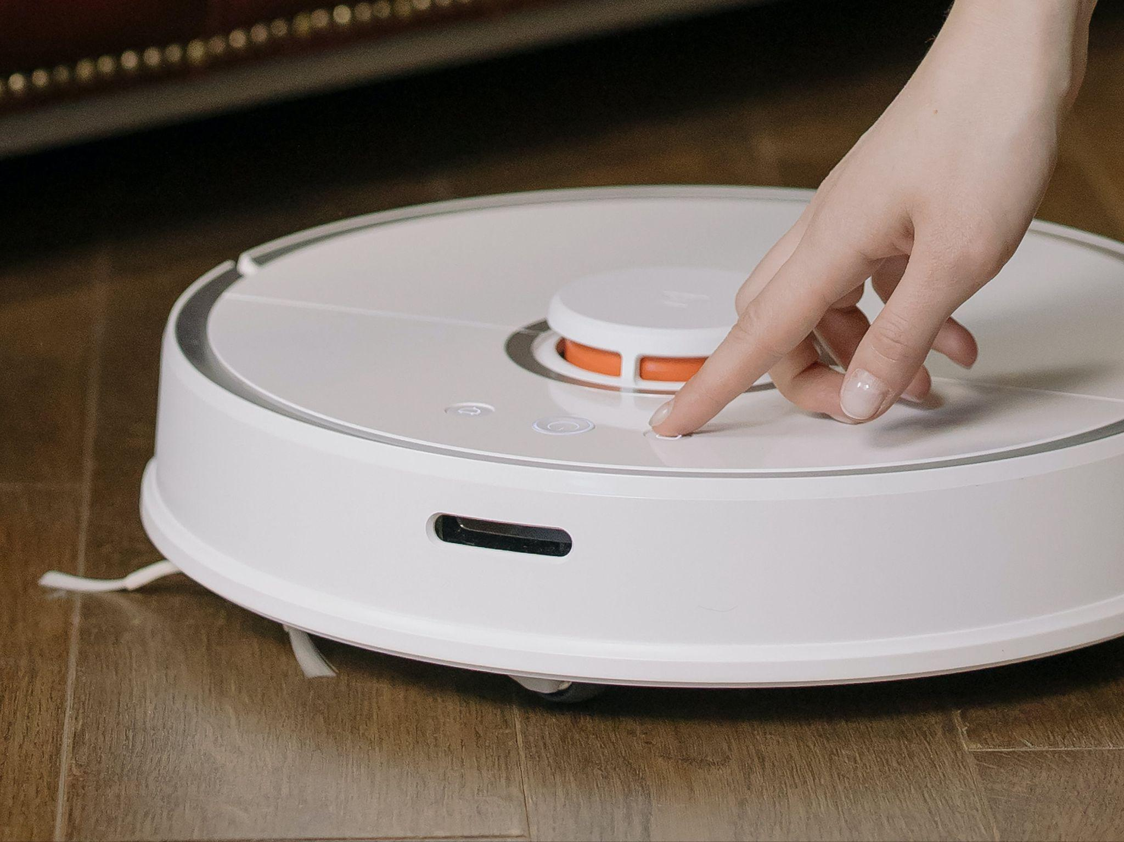
Robotic
Vacuum Cleaner
FINAL PRESENTATION
SAफAY 1.0
Sponsored by WEL,IIT Bombay
Guide - Prof. Veeresh Deshpande
Alok Kumar 210070006
Arya Agarwal 210070012
Sumit Londhe 210070089
Yabaji Pratik Sanjay 210070094
Image from pixel.com
MON-02
Notes:
Good [afternoon], everyone! I hope you're all doing well. My name is [Your Name], and I'm excited to be here today to walk you through our project, the "Robotic Vacuum Cleaner," under the guidance of Professor Veeresh Deshpande. Along with me, are Arya Agarwal, Sumit Londhe, and Yabaji Pratik Sanjay. Today, we're going to explore the fascinating world of robotic vacuum cleaners. Let's dive in!

Slide 2
Outline
Intro
Demo Video
Methodology
Challenges
Individual Contribution
Conclusion

Slide 3
Introduction

Slide 4
Need for Auto Vacuum Cleaner
Our Product
We strived to make a fully automatic vacuum cleaner with following additional features:-
Wifi controlled
Mopping
Edge Cleaning
Setting up Cleaning Alarms
Problems Solved
Robotic Vacuum Cleaner represents significant advancement over traditional methods.
Requires no human intervention thus saving time and effort.
Made for all home cleaning.
User-friendly features offer convenience and improves efficiency.

Slide 5
Demo Video
Link to Demonstration Video:
https://drive.google.com/file/d/1XXJBCTLLqHCSWckM8o-R1NIVCXx29p5G/view?usp=sharing

Slide 6
Methodology

Slide 7
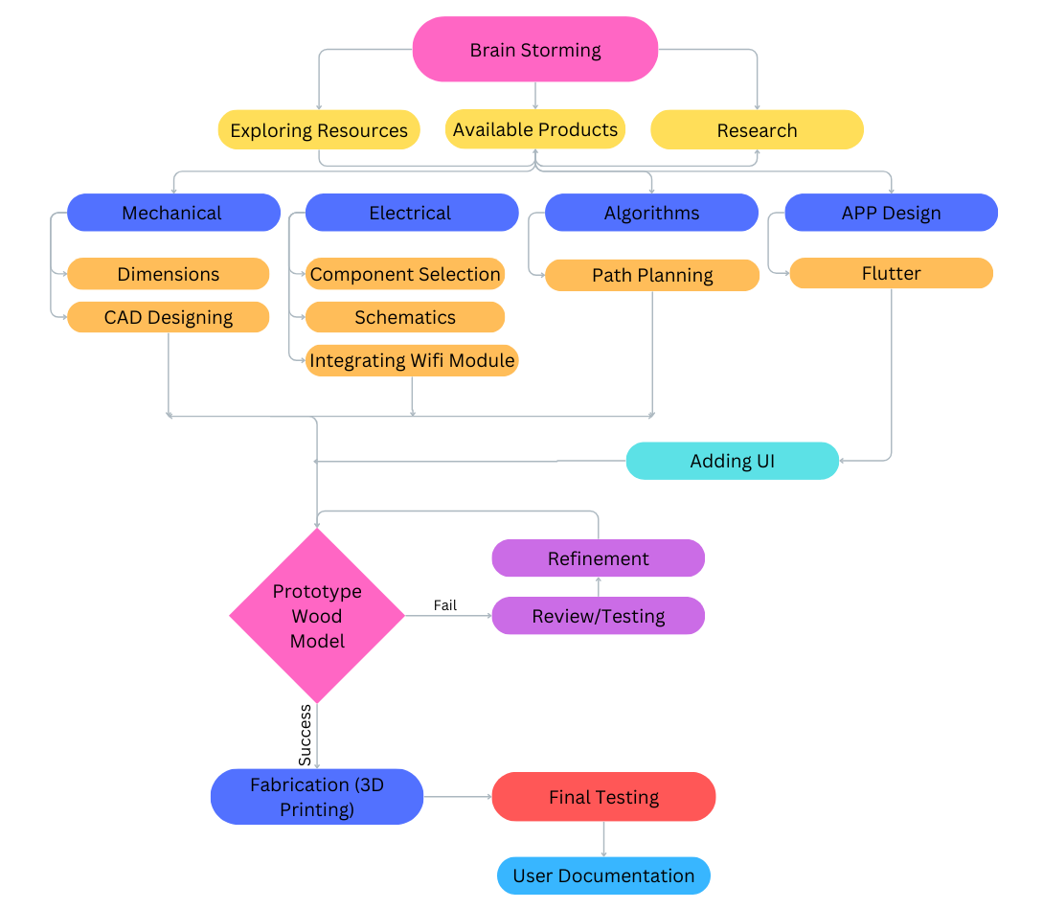
FlowChart
Notes:
Now I'll talk about the methodology we'll be using for our project
This flow chart illustrates the workflow of our project
We begin with collaborative brainstorming, which involves exploring available resources and products, as well as conducting research and literature surveys on the designs and functionalities of models available in the market
"Next, we divide our process into subtasks based on mechanical, electrical, algorithm, and app development.
In our mechanical phase, we'll define dimensions and weight based on specifications and design a CAD model for visualization. Electrical tasks involve selecting components, designing circuit schematics, and integrating a WiFi module. Algorithm work focuses on path planning and optimization. As for app development, our initial task is to learn Flutter and become familiar with it to create our app. Then we will make a prototype model from wood and Assembleing the mechanical and electronic components into a final prototype and conductiterative testing and refinement .
After a satisfactory number of tests we proceed to fabrication. Then next final testing and then documentation
// Also explain the chart in little bit detail.

Slide 8
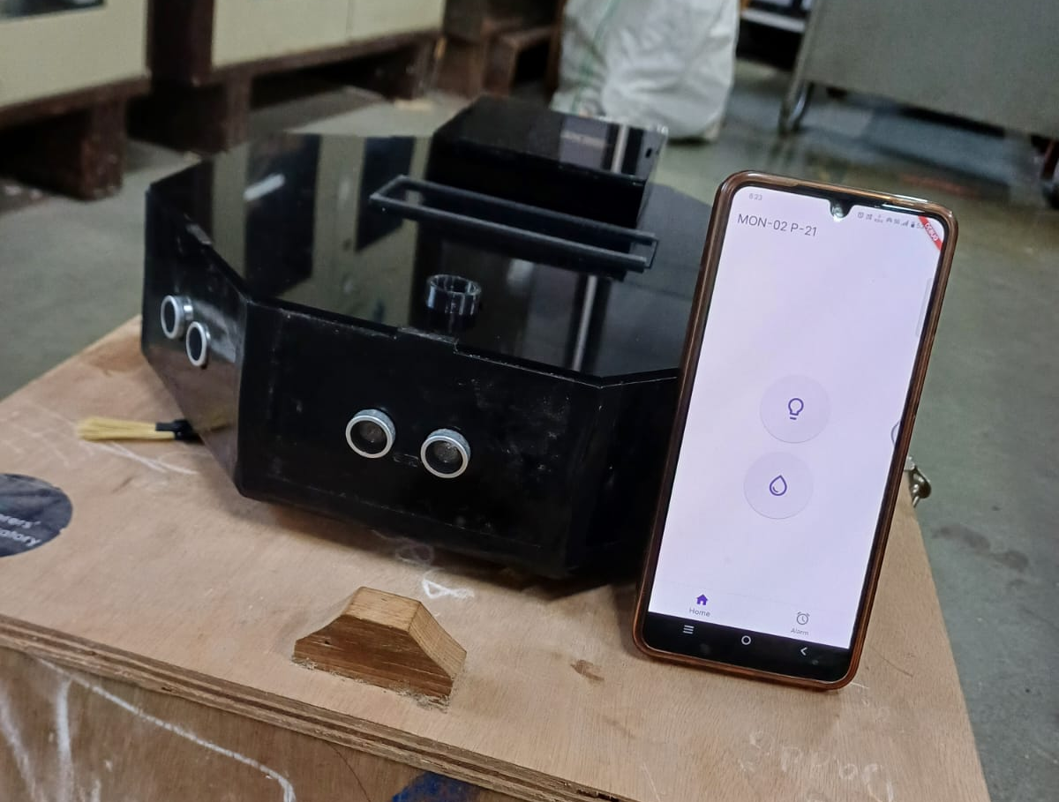
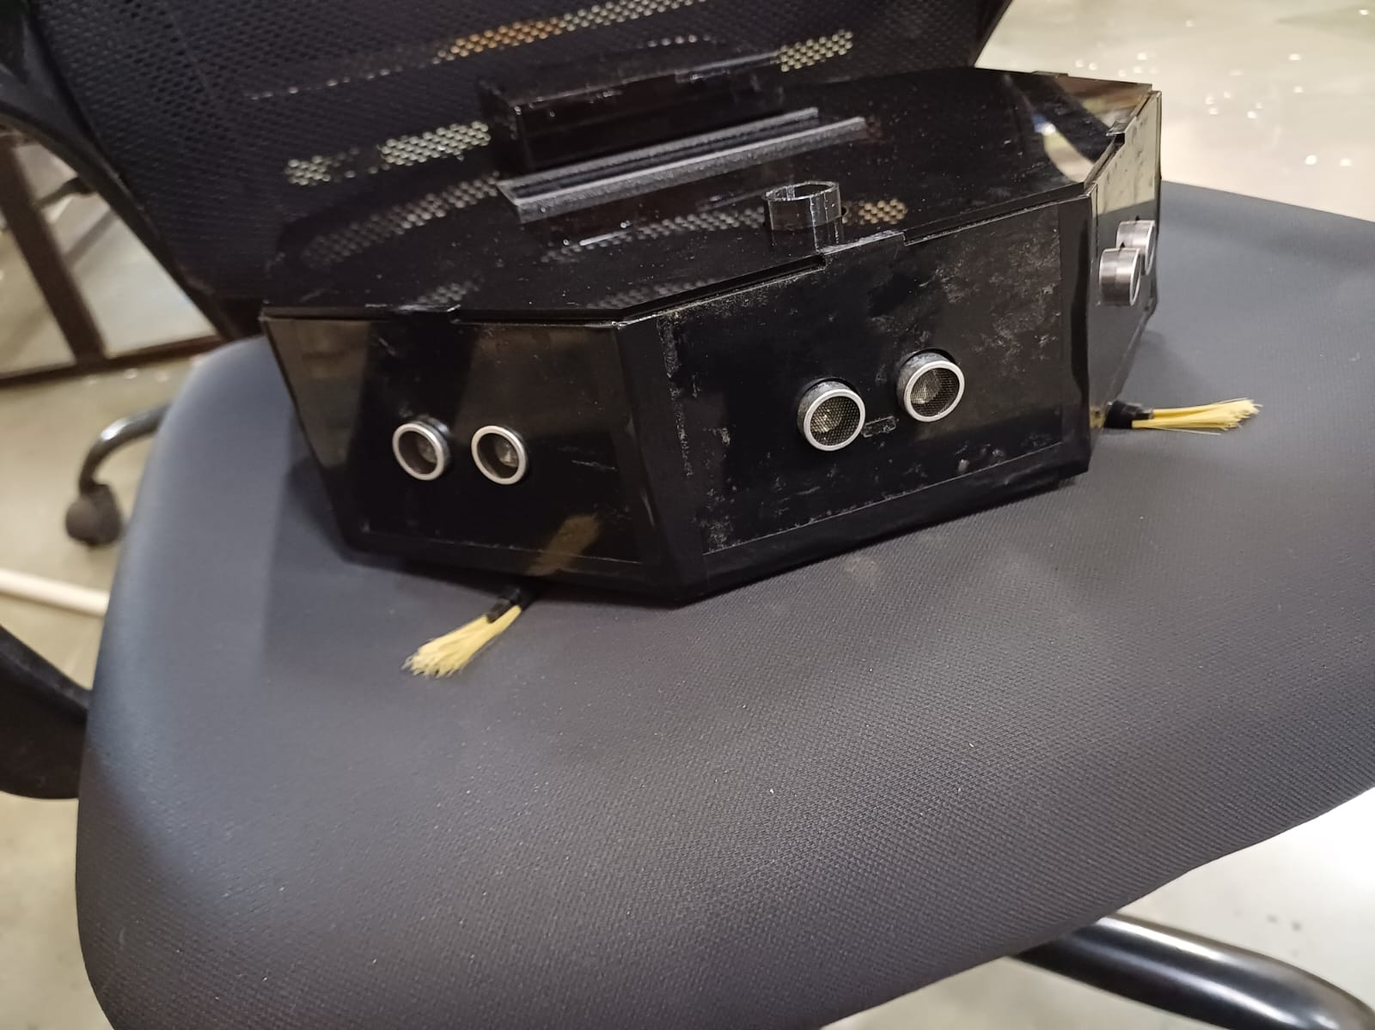
Addition to Reference Design
Listens to Your Phone
With the Smart App, you can easily control and operate your Robo from anywhere using a user-friendly mobile application. This adds convenience by allowing you to manage the cleaning process remotely
Edge Cleaning and Spot Cleaning
Add two small rotating brushes in front to increase cleaning coverage,especially in corners and edges. This design improves overall cleaning effectiveness but might raise maintenance needs and costs

Slide 9
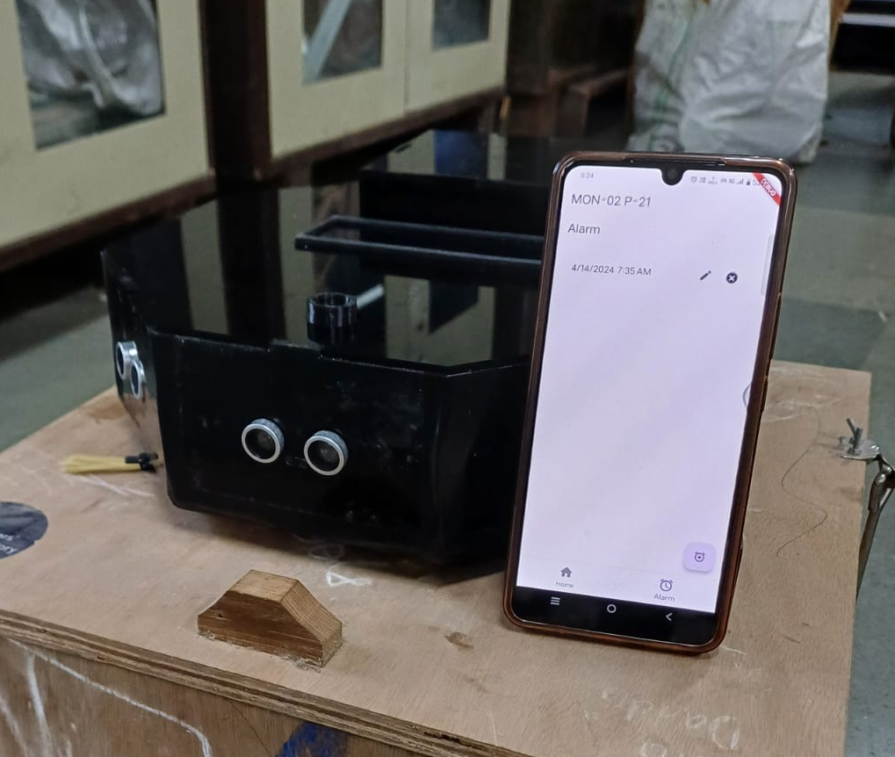
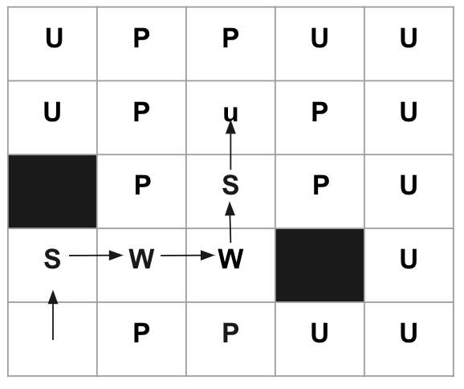
Schedule Cleaning Time
The Mobile App helps you to schedule cleaning your home from anywhere in the world. You can set your alarm and the vacuum cleaner automatically starts cleaning.
Effient mapping Algorithm
Equipped with ultrasonic sensors and mapping algorithms that enable it to know where it has already cleaned and where it still needs to go

Slide 10
Challenges Faced

Slide 11
Challenges Faced | Solution Found
Finding an efficient path algorithm for robotic vacuum cleaners. | Developed a mapping system with encoders for optimized room coverage.
Achieving precise 90-degree turns with unsynchronized encoders of the motors | Calibrated some constants with rigorous testing.
Difficulty in triggering the ultrasonic sensor efficiently due to WiFi code delays | Utilized the second core of the Raspberry Pi Pico for separate sensor triggering.
Making water-tight joints | Used Araldite and insulated tapping
PCB and modules were getting damaged due to high current flowing through them. | Designed a new PCB which cater all the current measurements and have increased track width.
Exact chips for motor driver, mosfet driver were difficult to find in market | Ultimately we had de-solder the chips from the modules we had
Stopping and controlling water flow was difficult to find for small sizes | Utilised Peristaltic Pump which acts as a valve as well as controlled speed

Slide 12
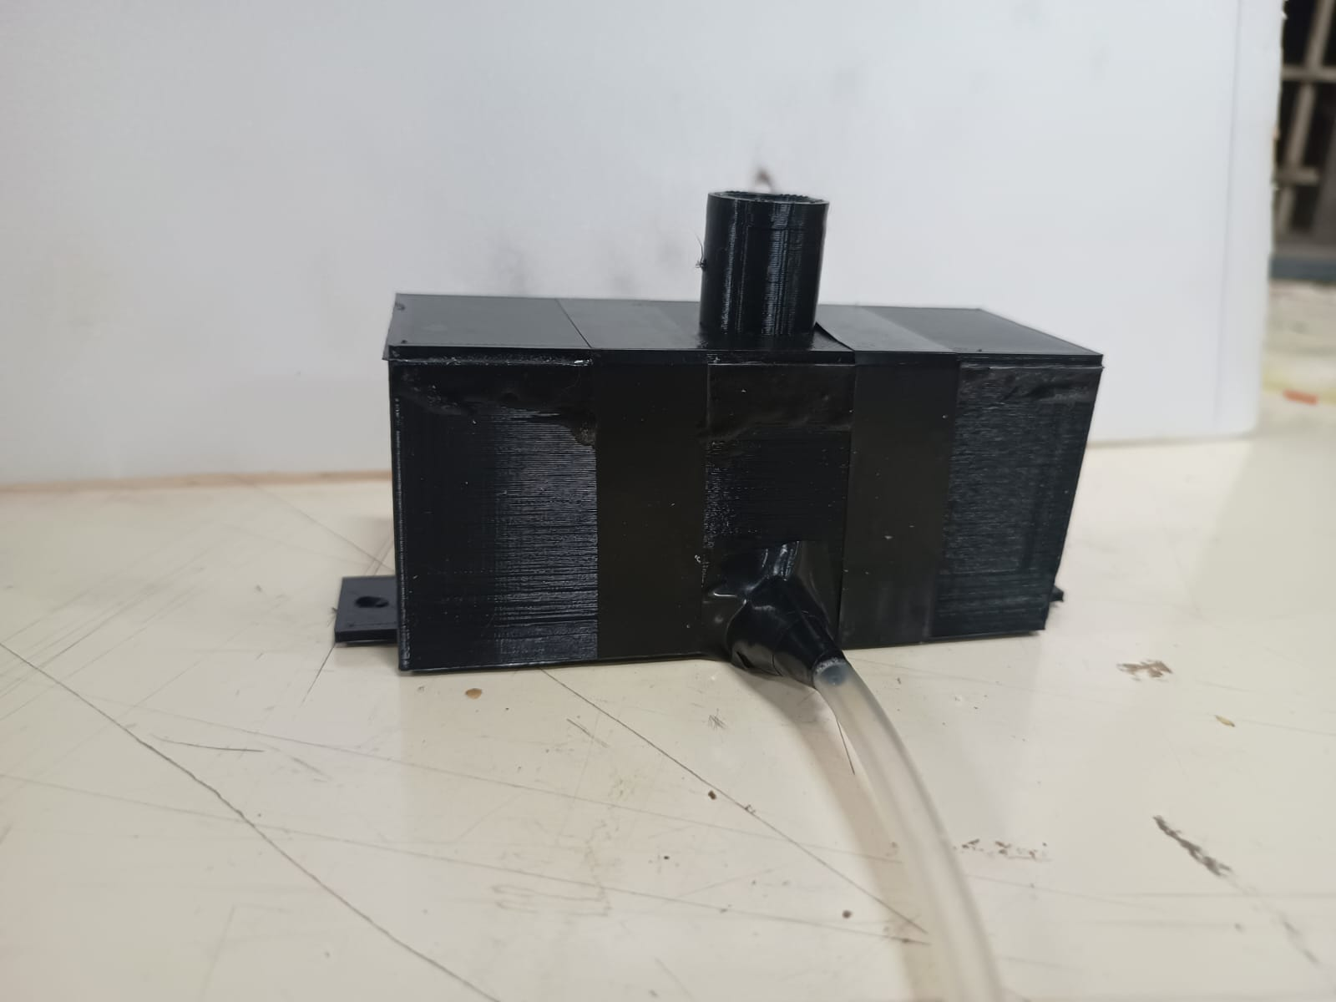
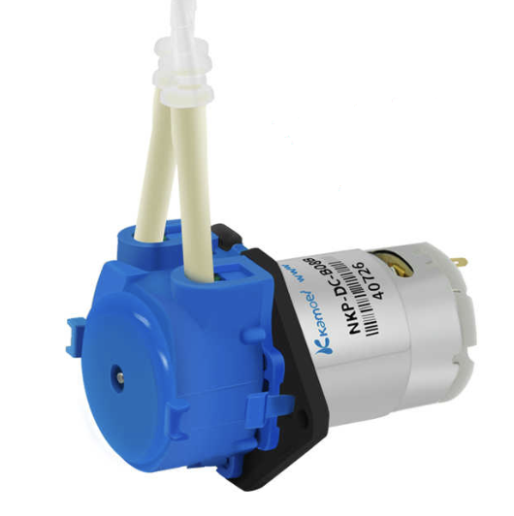

Slide 13
Broad Work Division
Member | Task | Working Hr (Ist Phase/ week) | Working Hr (2nd Phase / week)
Sumit | Algorithm (Phase 1 + Phase 2), Simulations, PCB | 7 | 5
Alok | Laser Cuttings, 3D Modelling, Mopping Mechanism, Preliminary Testings | 5 | 7
Pratik | 3D Design for Blower, Wifi+ App Integration, Algorithm (Phase 2), | 6 | 7
Arya | Algorithm (Phase 1), PCB, Preliminary Testing | 5 | 7

Slide 14
Conclusion

Slide 15
Project Status and Key Learning
List of specification completed:
Dry vacuum cleaning system
Wi-Fi integration for remote control via user-friendly app
Alarm control, remote on-off switch for added usability
Utilizes encoders for optimized mapping algorithms
Includes mopping feature for comprehensive cleaning
However we believe there are still improvements to be made in following areas :
Improving Algorithm
Adding different modes in UI
Improving aerodynamic for better suction.

Slide 16
Acknowledgement
We are obliged to receive cooperation from all departments in the lab. We would like to extend our gratitude to all individuals who were a part or contributed to this project in any or the other way.
A special thanks to:
S Tallur Sir, Ankur Sir, Mangeshwar Sir
TAs
WEL Staff (Special Mention to Mangesh Sir and Suraj Sir)
Ruchi Singh and Souhardhya Paul (ELA)
PCB Fabrication Dept.

Slide 17
Open for Feedback
📝

